Slide 1
THE ROLE AND FUNCTIONS OF THE
ACADEMIC LIBRARY
IN THE INFO-DOCUMENTARY SYSTEM:
A ROMANIAN APPROACH
Dr. Elena TÎRZIMAN, Professor
University of Bucharest, ROMANIA
elena.tirziman@litere.unibuc.ro
Dr. Maria MICLE, PhD, Senior Lecturer
West University of Timisoara, ROMANIA
maria.micle@e-uvt.uvt.ro
130 Years of Sofia University Library „St. Kliment Ohridski”
the International Science Conference
"The Modern Library - Learning Center, Dialogue of Culture, Innovation and New Technologies", 26-27.09.2018, Sofia

Slide 2
CONTENTS
The Romanian National System of Libraries: Specific Features and Atributions
The Academic Libraries – as part of RNSL: features
Information and Documentation (information literacy component)
Scientific and Cultural Heritage
Education Policy
Research
Public and Cultural Activities
Internationalisation / Multicultural policies
CONCLUSIONS
REFERENCES

Slide 3
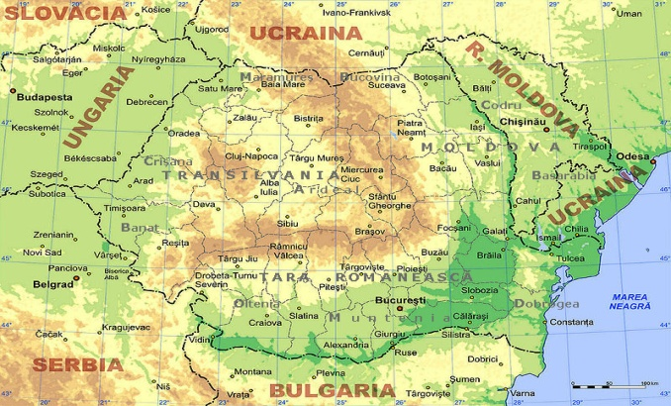
The Romanian National System of Libraries: specific features
At the national level, libraries with different specialities comprise the Romanian National System of Libraries [RNSL], meeting specific societal needs as well as a variety of demands from the population related to:
information
education
science
heritage
culture
integration
Using research data from projects in which the Romanian National Library has been a partner, or academic libraries, we present an analysis of the academic library functions in the context of the Romanian National System of Libraries.

Slide 4
The Romanian National System of Libraries:
specific features
TYPOLOGY OF THE ROMANIAN LIBRARIES
National Library
LIBRARIES FROM THE EDUCATIONAL SYSTEM
PUBLIC LIBRARIES
SCHOOL INFORMATION AND DOCUMENTATION CENTRES
ACADEMIC LIBRARIES
SCHOOL LIBRARIES
The oldest documentary mention of a library and of a school on the current day territory of Romania relates to the Cenad monastery founded by St. Gerard around 1000.
The first public lending library was opened in Timisoara in 1815; known today as the "Klapka „ library.

Slide 5
The Academic Libraries: information and documentation
Academic Libraries are grounded in information and documents. However, the twenty-first century has witnessed a revolution in the traditional methods of information-gathering and documentation, affecting documentary typology, methods and means of accessing information, user behaviour, etc.
Libraries are no longer clearly individualised, relatively isolated operating entities; instead, they are compelled to cooperate with one another, to complement other similar institutions, and to facilitate access to information that does not necessarily belong to them.

Slide 6
The Academic Libraries: information and documentation
An analysis of data supplied by Romanian libraries participating in the CRIDS [= CASIDRO=Catalogue of Romanian information and documenting structures=] project allows us to draw a few conclusions regarding their information and documentation activities, both traditional and modern (National Library of Romania, 2015).
With very few exceptions, libraries provide access to the Internet and have their own websites: 54 academic libraries (94.64% of the total number of academic libraries)
CRIDS statistics also show that libraries use specialised library software (ALEPH – 17 libraries; ALEPHINO – 1 library; ALICE – 1 library; CDS-ISIS – 1 library; LIBERTY – 15 libraries; QULTO – 2 libraries, COHA – 1 library). In addition, other academic libraries use other types of software that are developed locally.

Slide 7
The Academic Libraries: information and documentation
Some academic libraries used a variety of software packages to manage digital collections, including:
Digitool, Greenstone, D-Space and ToREAD.
The other libraries use display modes (without the Search and Find functions) of digital content in html, JavaScript, flash, etc. These are not true digital libraries but instead consist of different means of online presentation and document display in different forms:
PDF documents, image documents, virtual documents (using a “view” function), online exhibitions, webpages with links, etc.

Slide 8
The Academic Libraries: information and documentation
Clearly, much more investment and work is required to bring all libraries in the RNSL up to a level that allows them to provide the modern information and documentary products and services that meet users’ needs.
There is also much work to be performed to regulate the balance between traditional and modern methods of accessing information and between traditional and digital collections, as well as to provide easy access to a vast array of information products and services.

Slide 9
AL: Education Policy (information literacy component)
This function is considered a core objective for academic libraries, although it is also important to public libraries, which are considered “other schools”.
The importance of cultivating information literacy and a „love of reading” is particularly acute in our current era, which is marked by new information and communication technologies and major changes in reading behaviour. Technological progress should make life easier and more comfortable in all aspects, but in the long term, it can also promote inactivity.
Therefore, both physical and intellectual fitness should be encouraged and maintained. Reading, when regarded as a component of information literacy, keeps intelligence alive. For teachers, it expands knowledge and cultural horizons, whereas for students, reading abilities significantly improve academic performance.

Slide 10
AL: Education Policy (information literacy component)
The educational dimension of libraries is obvious in their provision of IL and reading programmes:
introductory IT courses, workshops and practical courses on a variety of topics,
science courses,
specific products and services for users,
and in their partnerships with institutions of education and culture.
All this is subordinate to the fundamental mission of libraries, which is to ensure access to information and knowledge, to train individuals and communities, and to actively participate in the life of the community.

Slide 11
AL: Research
Libraries are involved in research at all stages. More specifically, they are involved in the inception stage of research projects by providing information and documents, access to instruments and techniques, and training. After research is completed, they are involved in the dissemination of results. These research activities are specific to academic and specialised libraries.
The Library of the Romanian Academy is considered the largest specialised library in Romania, with specific collections for specialised research fields subordinate to the institutes belonging to the Romanian Academy. Romania’s National Library and academic libraries are of particular interest for researchers in the social sciences and the humanities.

Slide 12
AL: Research
RoLiNeST - Romanian Library Network Science & Technology, a portal and online collective catalogue developed within the framework of the National Unitary System of Scientific and Technical Information and Documenting, which aimed at unifying Romanian library systems.
RoLiNeST initially included online catalogues of the four central academic libraries (Bucharest, Cluj, Iasi, and Timisoara) and of the Library of the Polytechnic University of Bucharest; the catalogues of other academic libraries were added later.
Later, RoLiNeST integrated databases, electronic journals and even catalogues of foreign libraries, thus providing an integrated platform of information and documentation available to Romanian researchers.

Slide 13
AL: Research
Academic and specialised libraries have been involved – whether directly or through universities or research institutes – in the project “National Electronic Access to Research Literature” (ANELiS).
The general objective of the project was to ensure that public research institutes and universities had free access to electronic publications and databases for a period of three years. Finalised in 2013, it was followed by a new project, ANELiS+ (ANELiS, 2015).
Libraries in Romania are involved in research projects as partners of research institutes or universities both within the country and abroad. Libraries are interested in digitisation projects and exploitation of collections. They are also interested in developing new information products and services for users and supporting basic and applied research and development in the field of information and library science.

Slide 14
AL: Cultural and Scientific Heritage
Libraries have always been recognised as keepers of national and local cultural and scientific heritage.
The following are considered heritage libraries:
the Romanian National Library, The Library of the Romanian Academy are responsibles for collecting and preserving national documentary heritage;
Central Academic Libraries in Cluj, Iaşi, and Timişoara, responsible for collecting and preserving especially regional heritage from Transylvania, Moldavia, and Banat (and also the various county libraries, responsible for conserving and preserving local county heritage).

Slide 15
AL: Public and Cultural Activities
Activities for wider audiences and local communities are specific to public libraries, but in all Romanian academic libraries, there are many types of cultural activities.
Exhibitions on different topics, book presentations, conferences, meetings with cultural and scientific personalities, and different types of performances have become regular activities of public libraries.
These activities emphasise local, national, and world cultural heritage, thus contributing to the cultural and artistic education of their audiences.
Partnerships with entertainment institutions, with creative and cultural organisations, with artists from various fields, and with businesses contribute to the development of creative workshops and artistic and cultural events, including performing arts, festivals, exhibitions and conferences.

Slide 16
AL: Internationalisation / Multicultural policies
IFLA also undertook to support and find the most varied forms to contribute to the achievement of the goals of this agenda (The IFLA statement on multicultural library: The Multicultural Library - a gateway to a cultural diverse society in dialogue).
The academic library is an integrating institutional factor in the context of international mobility of populations. Romanians from the diaspora are supported to integrate in the countries of the European Union, in their turn the Romanian libraries develop internationalization policies and support for the integration of the multicultural groups.

Slide 17

UNESCO, Agenda 2030, New York, 2015
  Fig. 1. Obiectivele Agendei UNESCO 2030.
  Sursa: http://www.ifla.org/files/assets/hq/topics/libraries-development/documents/access-and-opportunity-for-all.pdf

Slide 18
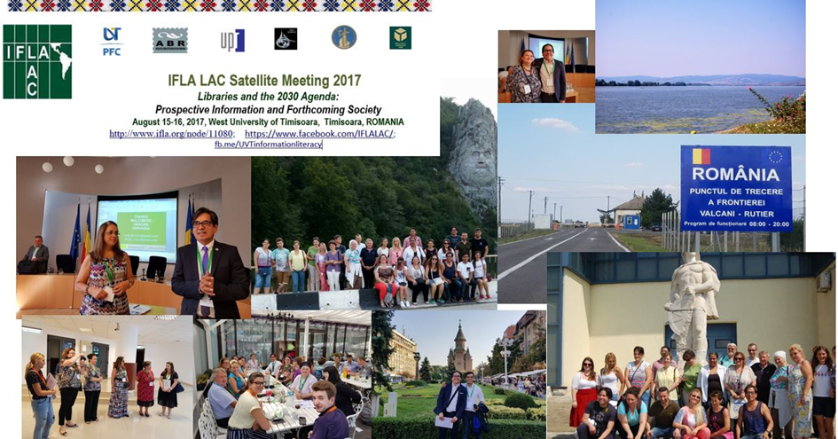
IFLA in ROMANIA: IFLA-LAC, Timisoara, 2017

Slide 19
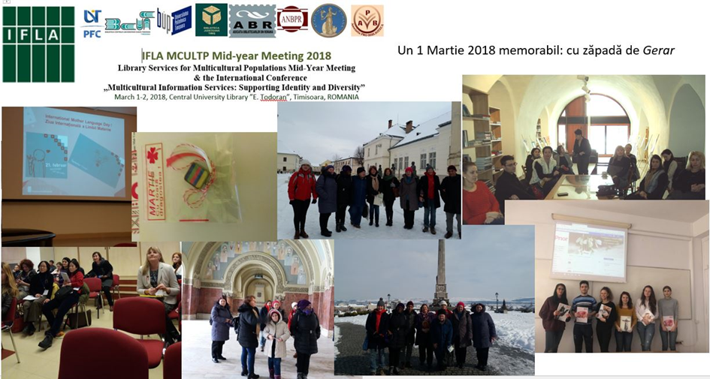
IFLA in ROMANIA: IFLA-MULTICULTI, TIMIȘOARA, 2018

Slide 20
IFLA IN ROMANIA. SATELITE MEETINGS, CONFERENCES
The international scientific events organized in Timişoara in 2017 and 2018 under the aegis of IFLA by the UVT- Information and Documentation Studies Program, with library professionals and librarians together, represent our (modest) contribution through which we wanted to draw the attention of the Romanian and international academic communities that multicultural libraries are called to meet the integration needs of ethnic communities; we are interested in, of course, the Romanian diaspora from the prism where it can be encouraged and directed to turn to the services of this institution in order to integrate better.

Slide 21
VI. CONCLUSIONS
Paradigms of information have evolved and changed under the pressure of new information technologies, causing deep ruptures in all aspects of the production, processing, communication, use, and preservation of information and documentary resources: the academic libraries procedures involving processing, organizing, communicating, and using information and documentary resources are conditioned by the use of an ICT infrastructure.
Libraries are therefore compelled to align their activities within such an infrastructure. There has also been a concurrent shift from documents to information.
In addition to traditional collections, libraries are compelled to develop products and services that provide easy access to information resources.
The mission of the academic libraries are a response to the social need for education and training, but they remain the institutions that can best meet the educational, cultural, and recreational needs of their university communities.

Slide 22
REFERENCES
ANELiS. (2015). Acces Naţional electronic la literatura ştiinţifică de cercetare. Retrieved from http://www.anelis.ro/; http://www.anelisplus.ro/. [Access date: 12.09.2015].
CASIDRO. (2015). Catalogul Structurilor de Informare şi Documentare din România [Catalogue of Romanian information and documenting structures]. Retrieved from http://www.bibnat.ro/biblioteci.php. [Access date: 12.09.2015].
IFLA. Access and opportunity for all. How libraries contribute to the United Nations 2030 Agenda. Accesibil la: http://www.ifla.org/files/assets/hq/topics/libraries-development/documents/access-and-opportunity-for-all.pdf [consultat la 12.04.2018].
Micle, M., & Lovasz, A. (2015). Communication with users through NTIC and integrated systems in school libraries in western Romania. In Libraries in V4+ countries and perspectives of their further development towards 2020 (pp. 81-88 / 89-95). Banská Bystrica: Štátna vedecká knižnica v Banskej Bystrici.
National Library of Romania. (2015). Statistici CASIDRO. [Unpublished documents].
RoLiNeST: Romanian Library Network Science & Technology. (2015). Retrieved from http://rolinest.edu.ro/V/35LC6VU3H5FKMXTJ1D3N95IE4LNH7Y3IMQUQ9DFB5BHAX866FR-02371?func=quick-1. [Access date: 12.09.2015].
UNESCO. Transforming our world: the 2030 Agenda for Sustainable Development. Resolution adopted by the General Assembly on 25 September 2015. Accesibil la: http://www.un.org/ga/search/view_doc.asp?symbol=A/RES/70/1&Lang=E [consultat la 12.04.2018].
Tîrziman, E. (2011). Le patrimoine documentaire national – Repères de l’activité de la Bibliothèque Nationale de la Roumanie. Les Cahiers de propriété Intellectuelle, 23, 277- 312.

Slide 23
Благодаря за вниманието!
Blagodarya za vnimanieto!

